Slide 1


Which European Capital for a GetAway?
Andrea Dal Bianco
15/03/2021

Slide 2


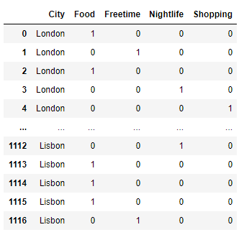
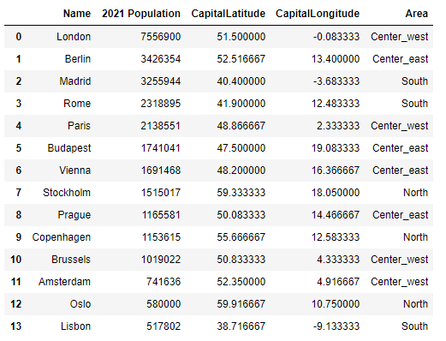
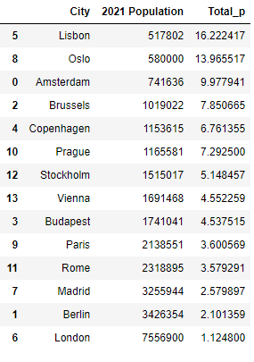
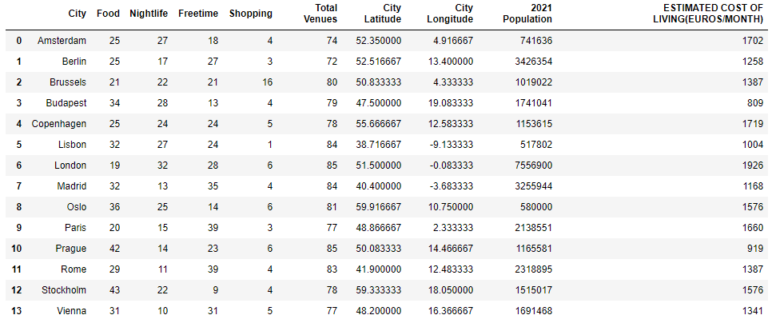
Business case
GetAway.com is developing new data-backed ideas for short trips.
When limiting the stay at a European Capital to 48 hours there is no time to look for the best place.
GetAway.com pre-analyses data and will get you to the right destination.

Slide 3
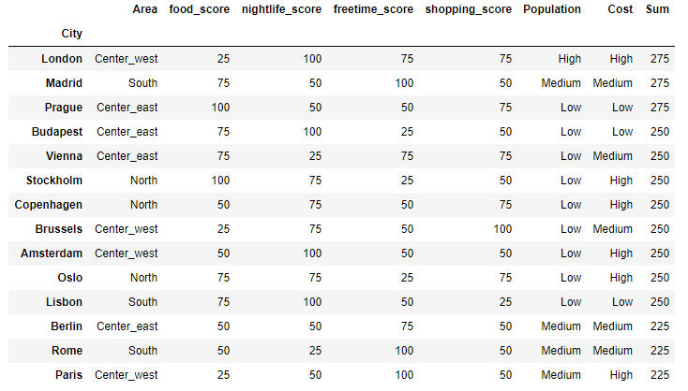
Cluster to survive
We retrieved and processed information regarding location, population, cost of living and type and number of venues for 14 European capitals, analyzed them using k-means clustering, set up a scoring system and published the final data in a clean and readable table.

Slide 4
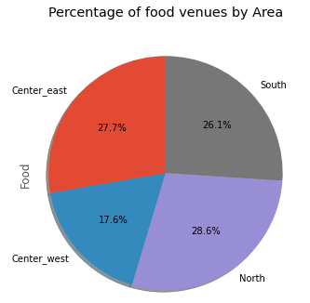
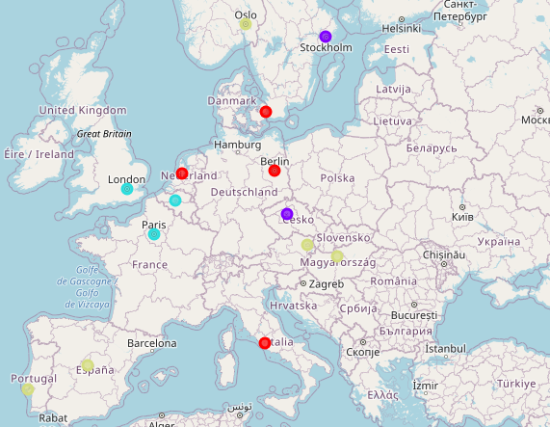
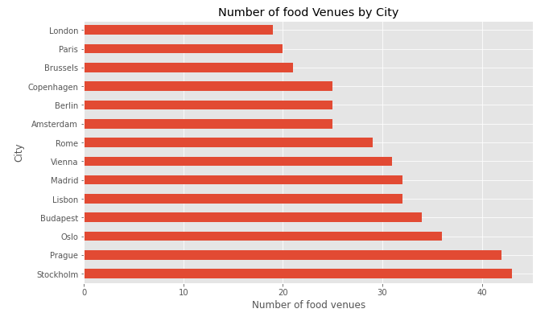
Focus on…Food venues
Best capitals for a food adventure are Prague and Stockholm
Avoid the Center-west area

Slide 5
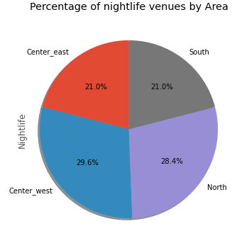
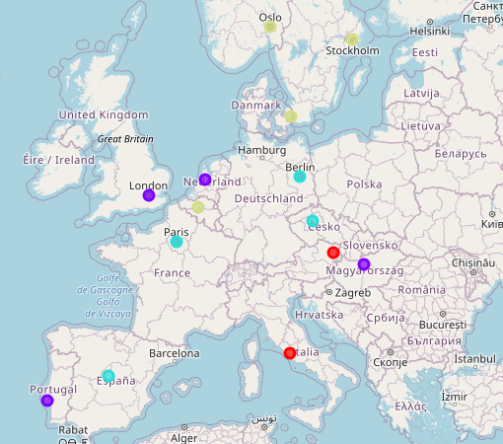
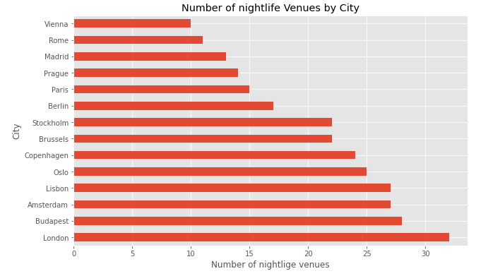
Focus on…Nightlife venues
Best capitals for a long night are London, Budapest, Amsterdam and Lisbon
South and Center-east are less likely to have variety of night-time venues

Slide 6
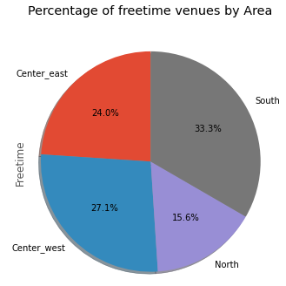
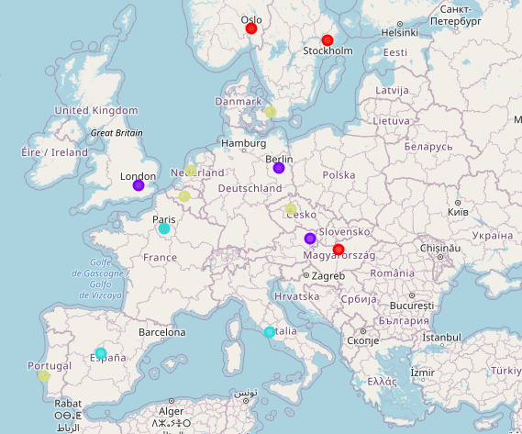
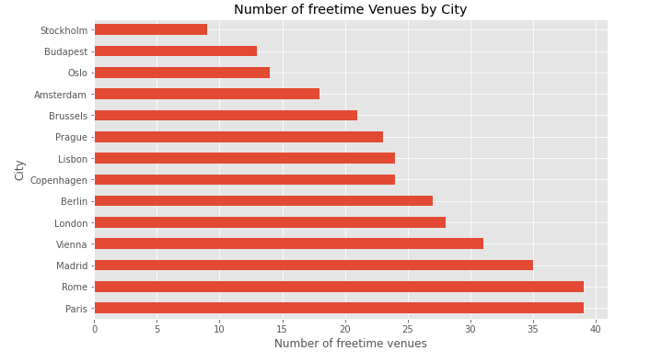
Focus on…Freetime venues
Best capitals for a full of culture and entertainment are Paris, Rome and Madrid
Avoid the North area

Slide 7
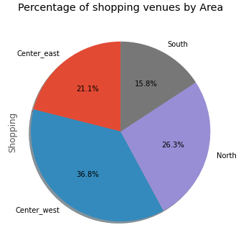
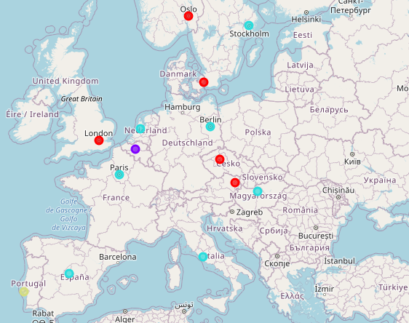
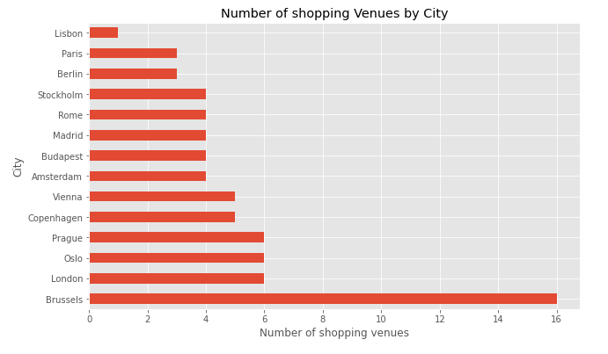
Focus on…Shopping venues
Brussels is your paradise for shopping
Center-west is good, avoid the South area

